Slide 1
Control Systems

Slide 2

By the end of this lesson you should be able to:
1. | State what the nervous and endocrine systems use to transmit information.
2. | Explain how the responses produced by the nervous and endocrine systems differ.
3. | State what structure acts like a bridge between the nervous and endocrine system, and how it accomplishes this.

Slide 3
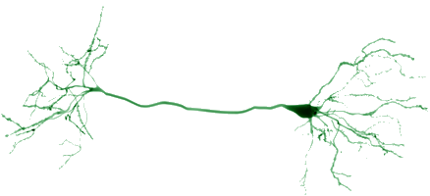
The nervous system
The nervous system is composed of nerve cells. These are special cells that transmit information from one cell to another by producing small electrical signals.

Slide 4
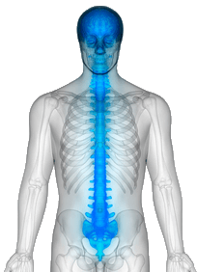
The brain and the spinal cord
There are two major organs in the nervous system: the brain and the spinal cord. These organs are made up of many different types of nerve cells. They receive information from the rest of the body. Using this information, they determine what the body needs to do.

Slide 5
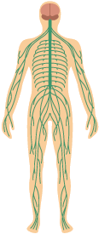
There are nerves distributed throughout the body.
Nerves carry information from the body to the brain and spinal cord. They also carry commands from the brain and spinal cord back out into the body, telling the body what it needs to do.

Slide 6

The brain and spinal cord are in charge
You can think of the brain and spinal cord as the boss of a company. The nerves throughout the body are like their secretary.
The rest of the company sends information to the secretary, who passes it on to the boss. The boss decides what the company needs to do, and then has the secretary send the word back out to the rest of the company.

Slide 7
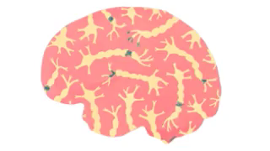
A key feature of the nervous system is that everything happens very quickly.
The electrical signals that nerve cells send travel quickly from one cell to another. This allows the body's response to occur only seconds after a stimulus was sensed.

Slide 8
Your nervous system works very quickly
For instance, when you place your hand on a hot surface, receptors in your skin pick up the temperature. They send this information to a nearby nerve, which carries the information to the spinal cord.
The spinal cord determines that the hand needs to be moved. It sends a command back down another nerve to the muscles in the arm. These muscles contract and move the arm away from the hot surface. All of this happens in less than a second!

Slide 9
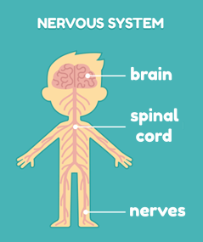
Let's quickly review what we learnt about the nervous system.
⋅ The nervous system is made of special cells called nerves.
⋅ Nerves use electrical signals to transmit information from one cell to another.
⋅ The electrical signals travel quickly, which allows the nervous system to produce very fast responses.

Slide 10
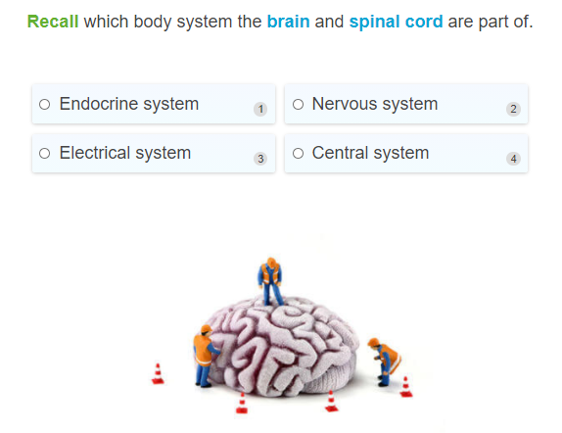

Slide 11
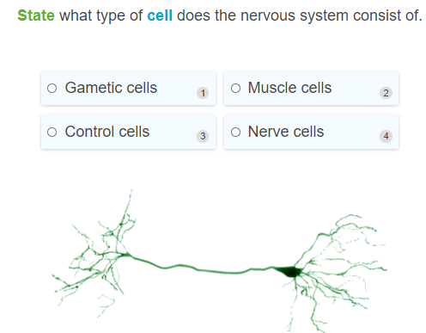

Slide 12
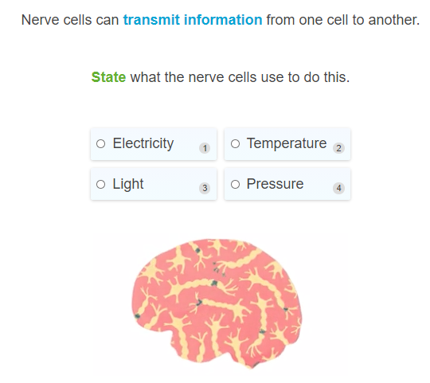

Slide 13
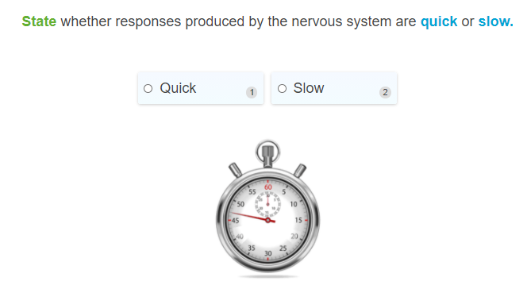

Slide 14


Slide 15

The endocrine system uses hormones
As you know, the nervous system uses nerve cells to transmit information. However the endocrine system uses something different. It uses chemicals called hormones.

Slide 16
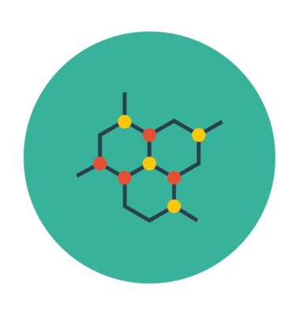
What are hormones?
Hormones are chemicals produced by special organs and glands. They travel through the blood system, bind to organs and cells and command those organs and cells to do certain things. This makes them little chemical messengers.

Slide 17
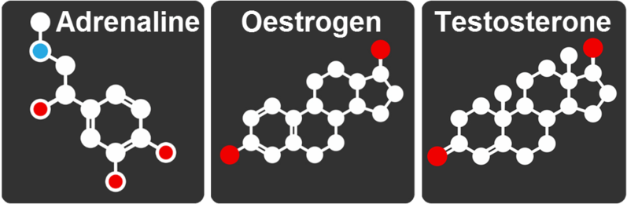
Adrenaline and Oestrogen
You are probably already familiar with some hormones.
Adrenaline is a hormone that prepares your body to deal with stressful situations, such as intense exercise or fright.
Oestrogen and testosterone are hormones that help your body develop properly as you mature.

Slide 18
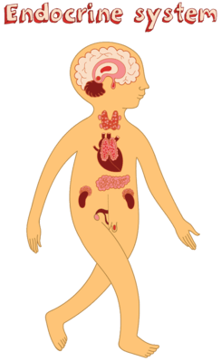
Hormones are produced by a number of organs and glands in the body.
Different organs produce different hormones. Together, these organs and glands make up the endocrine system.

Slide 19
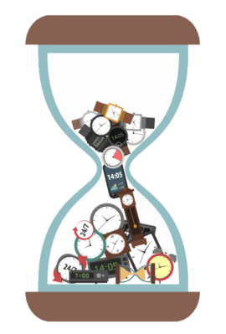
The endocrine system is slow
The key feature of the endocrine system is that the body's response is slow. This is because it takes time to produce hormones, and for those hormones to travel to where they need to go.
However, the response can last for a long time. This is because the response will continue so long as hormones are in the area, and it takes time to destroy or remove them.

Slide 20
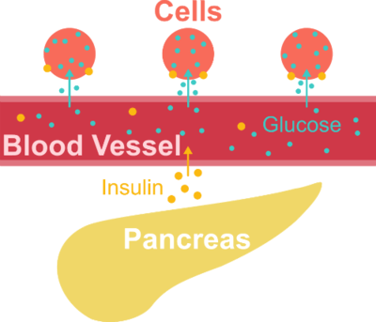
Let's look at an example of the endocrine system in action
Insulin is a hormone that controls the concentration of glucose (sugar) in the blood. When blood glucose levels rise, such as after eating, an organ called the pancreas excretes insulin into the blood.
The insulin binds to cells and tells those cells to absorb glucose from the blood. This returns blood glucose concentrations to normal levels.

Slide 21
Like most endocrine responses, the response produced by insulin is slow and long-lasting.
After blood glucose levels start to rise, it takes several minutes for cells to start absorbing glucose from the blood. The cells will keep absorbing glucose until normal blood glucose levels are restored. This can take over an hour.

Slide 22
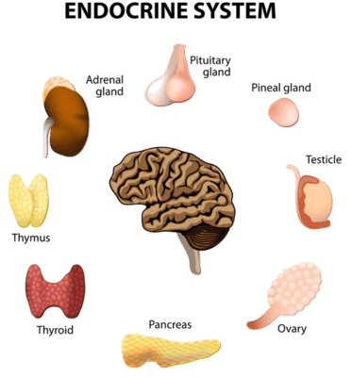
Let's review what we learnt about the endocrine system.
⋅ The endocrine system uses chemicals called hormones to transmit information.
⋅ Hormones are produced by a number of organs and glands.
⋅ The endocrine system produces slow and long lasting responses.

Slide 23
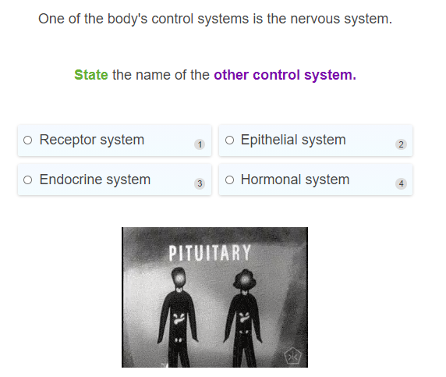

Slide 24
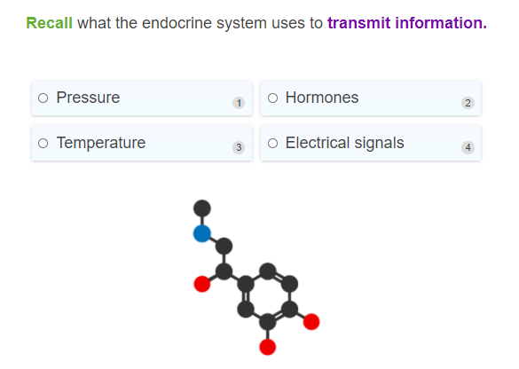

Slide 25
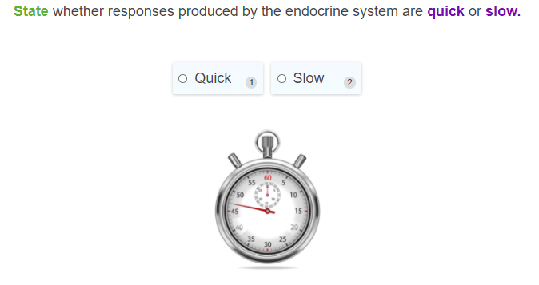

Slide 26
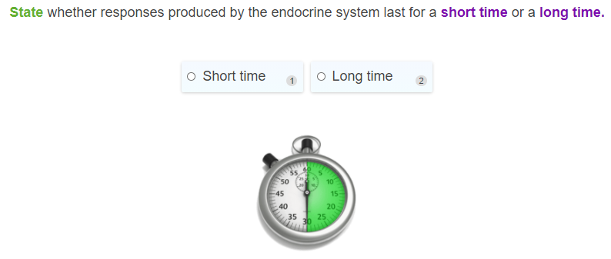

Slide 27
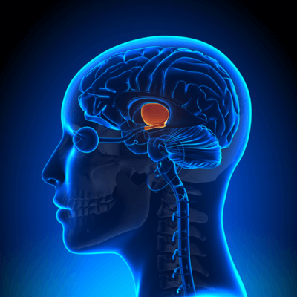
The nervous and endocrine system can also work together.
This tends to be controlled by a section of the brain called the hypothalamus.

Slide 28
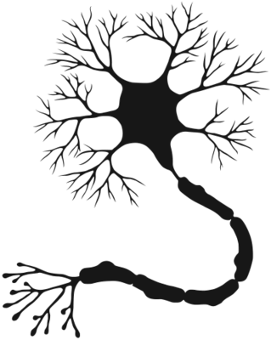
The hypothalamus controls several aspects of homeostasis, including body temperature, appetite and thirst.
When dealing with one of these things, nerves will send information to the hypothalamus. It will process this information and decide what the body needs to do.

Slide 29
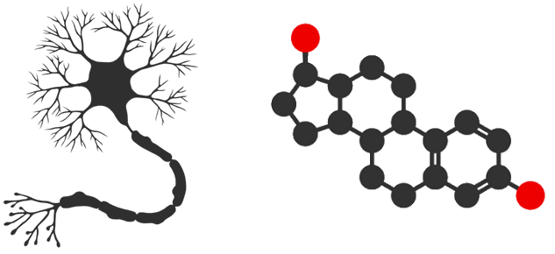
The hypothalamus acts like a bridge between the nervous and endocrine system.
The hypothalamus can send a command out to the body using nerves. Or, it can produce hormones that interact with the endocrine system. Sometimes, it does both!

Slide 30
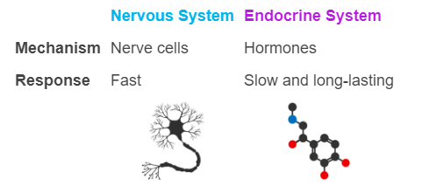
In summary, the body is controlled by two systems: the nervous and endocrine systems.
Each system has its benefits and limitations. A region of the brain, called the hypothalamus, can act as a bridge between the two systems.

Slide 31
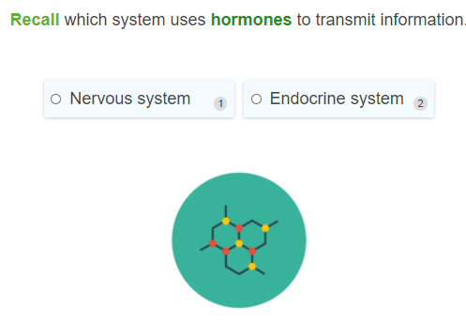

Slide 32
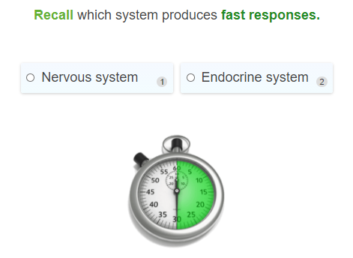

Slide 33
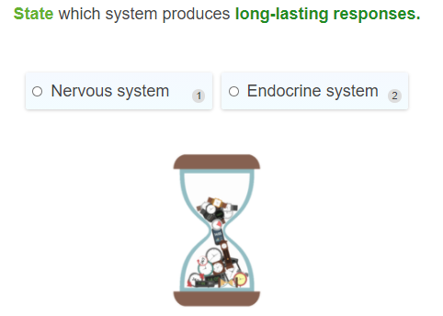

Slide 34
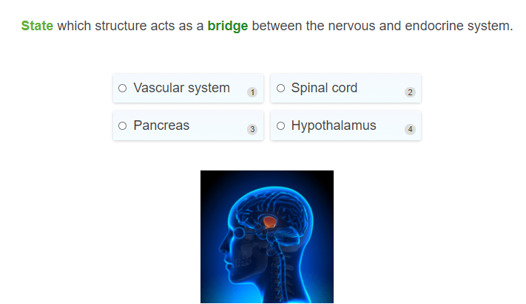

Slide 35
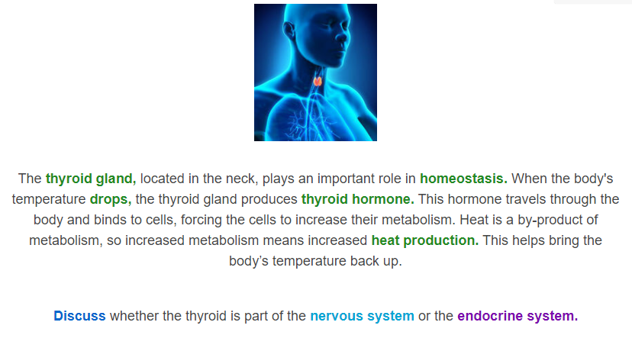

Slide 36
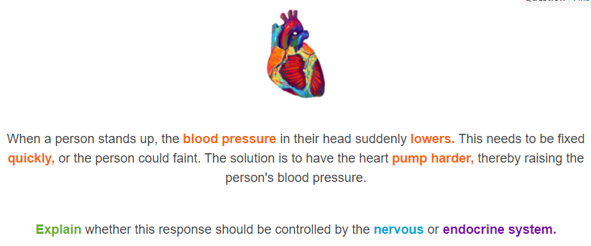

Slide 37
